Slide 1
POST-ML Session With Deployment

Slide 2
Content
ML Preview of Classification
ML Preview of Some ML Algorithms
Hands on Deployment of Ensemble Model
Review Quiz & Assignment

Slide 3
What is Supervised Learning?
Goal: Predict target variable(label) given the predictor variables(features)
Classification - Target variable is categorical
Regression - Target variable is continuous
Purpose
- automate time consuming and expensive manual tasks - eg. a doctor’s diagnosis
- Make predictions about the future- eg. will a customer click an ad or not
Main requirement - labelled data ( historical, experimental)

Slide 4
Scikit Learn for Machine Learning
All ML models are implemented as Python Classes
They implement the algorithms for learning and predicting
Store information learned from the data
Training the model on the data = fitting a model to the data –using .fit() method
Predicting the labels of new data– using .predict() method
Scikit Learn API requires
Data as a numpy array or pandas dataframe
Features be numerical
No missing values

Slide 5
Supervised Learning Steps
. 1.Data Acquisition
- Data sanity checks
- Data Cleaning- - Check for nulls, zero errrors, corrupt characters
2. Exploratory Data Analysis – univariate & bivariates & correlations
3. Data Preprocessing
-separate features and label
- Do the label encoding
- Solve data imbalance issue (if needed)
- Do a train test split
-scale the features (if needed, though it’s a good practice to scale the features)

Slide 6
Supervised Learning Steps
4. Model Building with training data – Fit the model
5. Model evaluation with test data – Check the metrics
6. Model optimization-Hyperparameter tuning
7. Model interpretation
8. Deployment

Slide 7
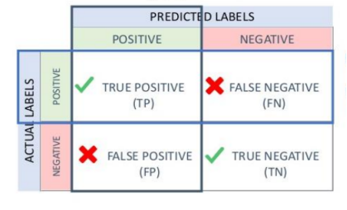
Evaluation Metrics for Classification- Confusion Matrix
Precision and Recall are metrics that are used for evaluating the performance of a classification algorithm. These can be understood more clearly using a confusion matrix as shown beside.
Precision is the proportion of true positives among those predicted positives. So Precision is a % expressing the accuracy with which positive classes are predicted. As a formula Precision = TP/(TP+FP)
Recall on the other hand is the proportion of true positives among those that are actually positive. So recall is a % expressing the capacity of the model to recall positive values. As a formula Recall =TP/(TP+FN)
These measures are very useful in a marketing scenario

Slide 8
Algorithms for Classification
K Nearest Neighbors
Logistic Regression
—---------------------------------
Decision Trees
Voting Classifier
Bagging Classifier
Random Forest
Naive Bayes
—----------------------------------
Gradient Boosting
Adaboost Classifier
XgBoost Classifier

Slide 9
KNN
The k-nearest neighbors (KNN) algorithm is a supervised machine learning algorithm.
KNN assumes that similar things exist in close proximity. This implies that similar data points are close to each other. KNN calculates the distance between points on a graph to decide similarity
The distance can be of any type, e.g., Euclidean, Manhattan, etc.

Slide 10
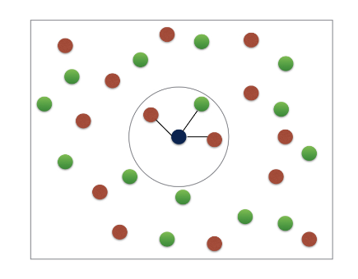
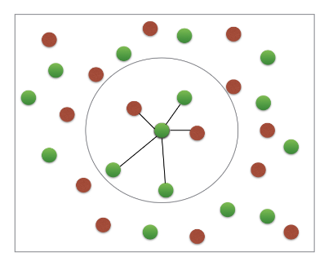
K- Nearest Neighbors
Basic Idea : predict the label of a data point by
Looking at “k” closest labelled data points
Taking a majority vote

Slide 11
KNN Advantages and Disadvantages
Advantages
Very easy to implement.
This algorithm can be used for both classification and
Regression.
Since data is not previously assumed, it is very useful in cases of nonlinear data.
The algorithm ensures relatively high accuracy.
Disadvantages
It is a bit more expensive as it stores the entire training data.
High memory storage requirements for this algorithm.
Higher sets of values may lead to inaccurate predictions.
Highly sensitive to the scale of the data.

Slide 12
KNN Uses
The following are some of the areas in which KNN can be applied successfully:
KNN is often used in banking systems to identify if an individual or organization is fit for a grant or a loan based on key characteristics.
KNN can be used in Speech Recognition, Handwriting Detection, Image Recognition, and Video Recognition.
A potential voter can be classified into categories based on characteristics (like “voter” or “non-voter”) for elections

Slide 13
Naïve Bayes
What is it ? Statistical method for classification.
Supervised Learning Method.
Assumes an underlying probabilistic model, the Bayes theorem. Can solve problems involving both categorical and continuous valued attributes
Naive Bayes classifier works on the principles of conditional probability as given by the Bayes theorem

Slide 14
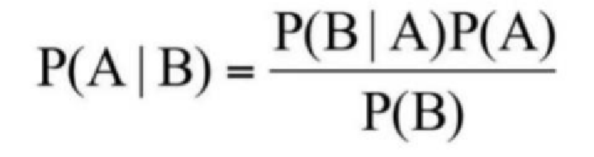
Naïve Bayes
Bayes Theorem gives the conditional probability of an event A given another event B has occurred
Where, P(A/B) = Conditional Probability of A given B
P(B/A) = Conditional Probability of B given A
P(A) = Probability of event A
P(B) = Probability of event B

Slide 15
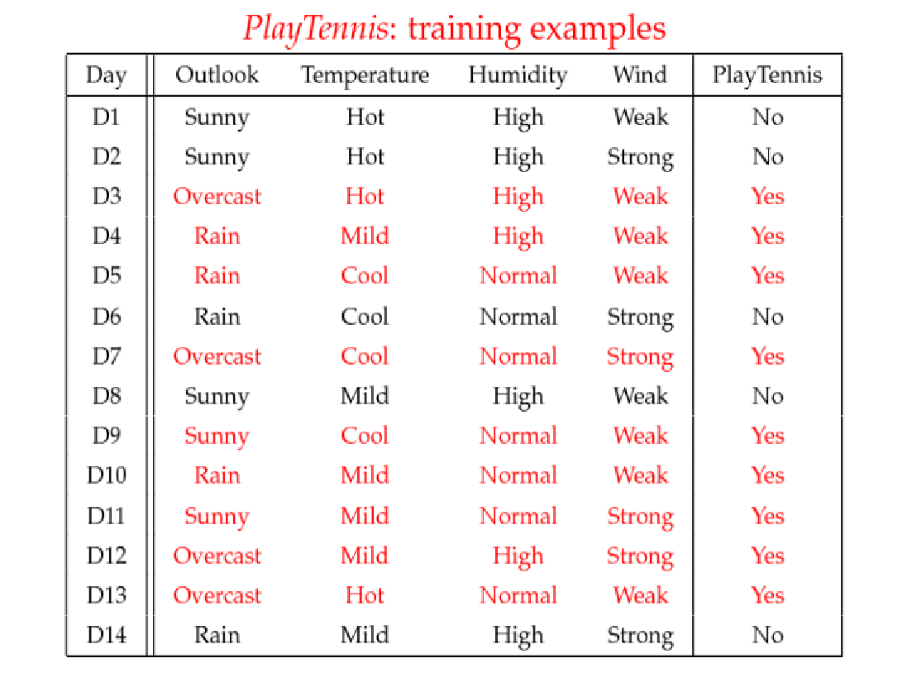
Example : To Play or Not to Play

Slide 16
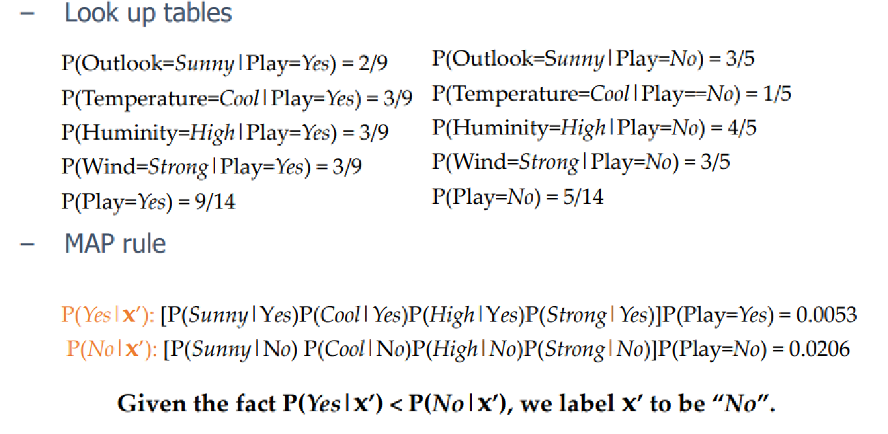
Example : To Play or Not to Play

Slide 18
Advantages vs Disadvantages of Naïve Bayes
Advantages
This algorithm works quickly and can save a lot of time.
Naive Bayes is suitable for solving multi-class prediction problems.
Naive Bayes is better suited for categorical input variables than numerical variables.
Disadvantages
Naive Bayes assumes that all predictors (or features) are independent, rarely happening in real life. This limits the applicability of this algorithm in real-world use cases.
This algorithm faces the ‘zero-frequency problem’ where it assigns zero probability to a categorical variable whose category in the test data set wasn’t available in the training dataset. It would be best if you used a smoothing technique to overcome this issue.

Slide 19
Use Cases of Naïve Bayes
Text Classification
Most of the time, Naive Bayes finds uses in-text classification due to its assumption of independence and high performance in solving multi-class problems. It enjoys a high rate of success than other algorithms due to its speed and efficiency. It is also an excellent spam filter for emails.
Sentiment Analysis
One of the most prominent areas of machine learning is sentiment analysis, and this algorithm is quite useful there as well. Sentiment analysis focuses on identifying whether the customers think positively or negatively about a certain topic (product or service).
Recommender Systems
With the help of Collaborative Filtering, Naive Bayes Classifier builds a powerful recommender system to predict if a user would like a particular product (or resource) or not. Amazon, Netflix, and Flipkart are prominent companies that use recommender systems to suggest products to their customers.

Slide 20
Decision Trees
A supervised Algorithm which uses tree structure to model relationships among the features and the potential outcomes
It breaks down dataset into smaller subset with increase in depth of tree
It’s a flowchart for deciding how to classify a new observation
Consists of Root ,branches and leaves
Takes top down greedy approach known as recursive binary splitting

Slide 21
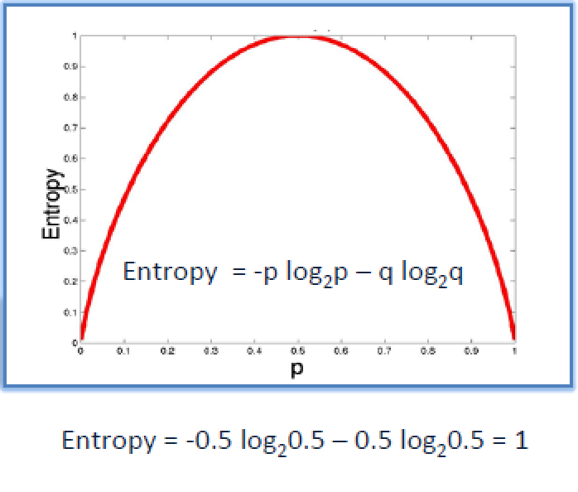
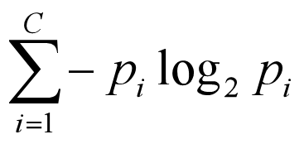
Loss Function for Decision Tree
For classification the loss function is measured in terms of a measure of randonmess known as Entropy .
The entropy graph is shown below we see that entropy is maximum when p=0.5 and minimum when p=0 or p=1
Entropy is given by the formula
Where i=1, 2,3… C
If C=2 it means the feature has 2 classes

Slide 22
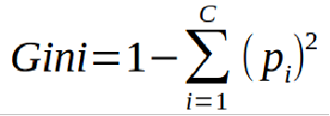
Gini Index
A measure of impurity similar to entropy
Lower the value of gini index higher the homogeneity
Calculate gini index for sub-nodes
Calculate gini for split using weighted Gini score of each node of that split
Formula -

Slide 23
Decision Tree Algos
ID3 (Iterative Dichotomiser 3) – developed by Ross Quinlan. Creates a multi branch tree at each node using greedy algorithm. Trees grow to maximum size before pruning
C4.5 succeeded ID3 by overcoming limitation of features required to be categorical. It dynamically defines discrete attribute for numerical attributes. It converts the trained trees into a set of if-then rules. Accuracy of each rule is evaluated to determine the order in which they should be applied
CART (Classification & Regression Trees) is similar to C4.5 but it supports numerical target variables and does not compute rule sets. Creates binary tree. Scikit uses CART

Slide 24
Implementation Steps
Calculate entropy for each branch or split
Split the dataset by selecting attribute with highest information gain
Repeat the above steps on each branch
A branch with entropy of zero is leaf node

Slide 25
Pruning
Decision tree tends to get overfit with training sample and becomes too large and complex. A complex and large tree poorly generalizes the new samples data whereas a small tree fails to capture the information of training sample data.
Pruning may be defined as shortening the branches of tree. The process of reducing the size of the tree by turning some branch node into leaf node and removing the leaf node under the original branch.
Pruning is done by controlling the hyperparameter called max depth

Slide 26
Hyperparameters of Decision Trees
Maximum Depth- the largest length between the root to leaf. A tree of maximum depth k can have at most 2**k leaves.
Minimum number of samples per leaf- we can set a minimum for the number of samples we allow on each leaf.
Minimum sample split - the minimum number of samples required to split an internal node
Criterion – ‘gini’ or ‘entropy’

Slide 27
Pros and Cons of Decision Trees
PROS
Easy to explain especially to non technical people
Highly interpretable as it is a visual model
Can deal with Categorical and Numerical Outcome Variables
It is fast, efficient and a low bias model
CONS
Easily influenced by outliers
High Variance model and thus very prone to overfitting
Low Predictive accuracy

Slide 29
ENSEMBLE LEARNING

Slide 30
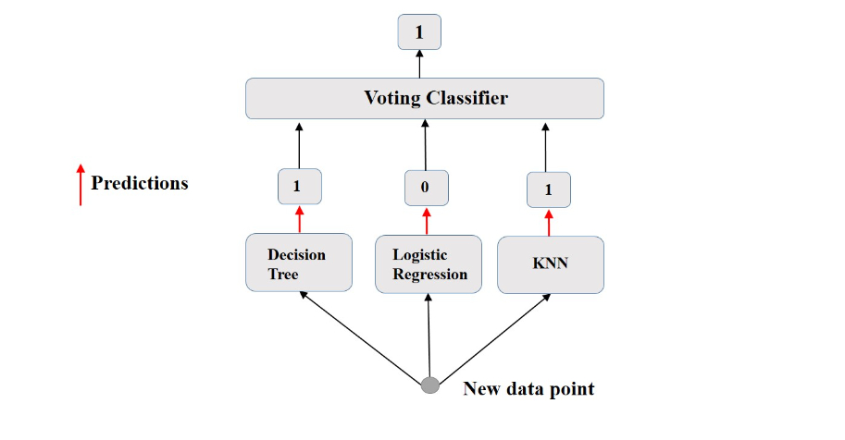
Voting Classifier

Slide 31
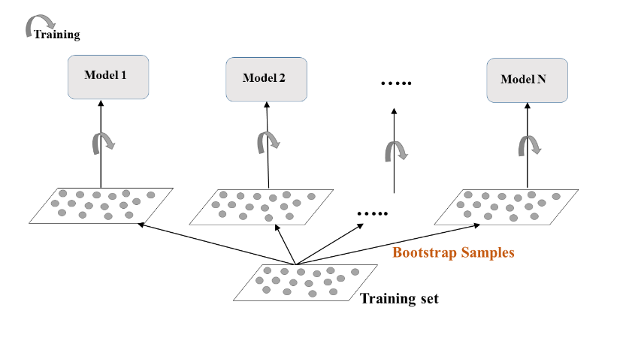
Bagging Classifier Training

Slide 32
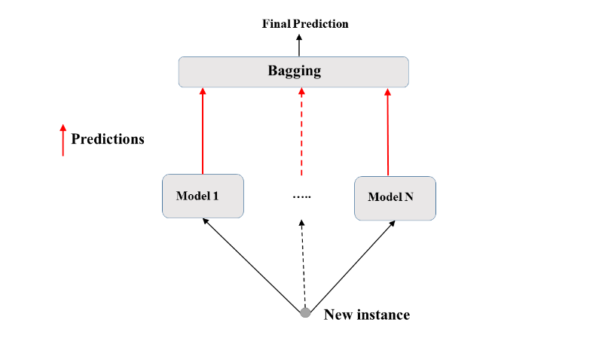
Bagging Classifier Prediction

Slide 33
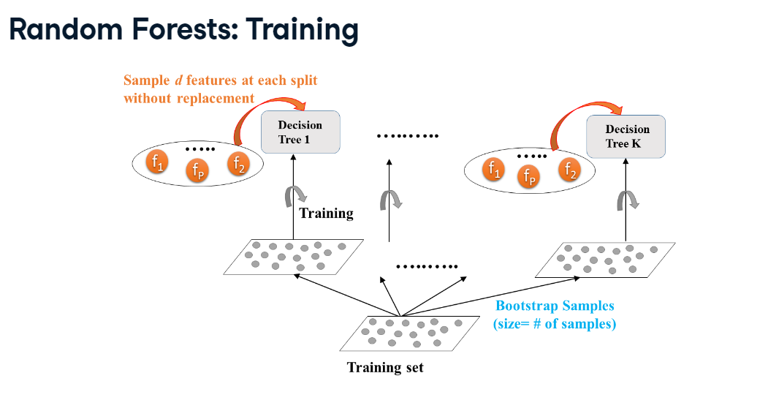

Slide 34
Random Forest
Random forests are a form of ensemble learning where we use the concept of bagged trees
Random forests provide an improvement over bagged trees by way of a random small tweak that decorrelates the trees.
As in bagging, we build a number of decision trees on bootstrapped training samples
But when building these decision trees, each time a split in a tree is considered, a random sample of m predictors is chosen as split candidates from the full set of p predictors. The split is allowed to use only one of those m predictors. A fresh sample of m predictors is taken at each split, and typically we choose m ≈ √p

Slide 35
PROS of Random Forest
It reduces variance as taking many trees from n bootstrapped samples and averaging their prediction leads to lower variance
It also reduces bias in the dataset by decorrelating the trees which is a problem with imbalanced datasets
Random forests overcome this problem by forcing each split to consider only a subset of the predictors. Therefore, on average (p − m)/p of the splits will not even consider the strong predictor, and so other predictors will have more of a chance. We can think of this process as decorrelating the trees, thereby making the average of the resulting trees less variable and hence more reliable.

Slide 36
Hyperparameters for Random Forest
Criterion- can choose between ‘entropy and ‘gini’
Maximum Depth- the largest length between the root to leaf.
Minimum number of samples per leaf- we can set a minimum for the number of samples we allow on each leaf.
Minimum sample split - the minimum number of samples required to split an internal node
Maximum features - the number of features that one looks for in each split. We can shoose between ‘sqrt’ and ‘log2’

Slide 37
Hands on Deployment
We will create a medical diagnostic web app by working on the Pima Diabetes Dataset and create a classification model and will deploy it using streamlit
Dependencies
Jupyter Notebook
VS Code
Github account local Git Bash
Streamlit sharing account connected to Github (share.streamlit.io)

Slide 38
Assignment
Create an optimized model to predict employee attrition and deploy it as a streamlit model

Slide 39
Reference Books
Introduction to Statistical Learning by Gareth James (Springer Publications)
Introduction to Machine Learning with Python by Andreas Muller & Sarah Guido (O’Reilly Publication)

